Slide 1
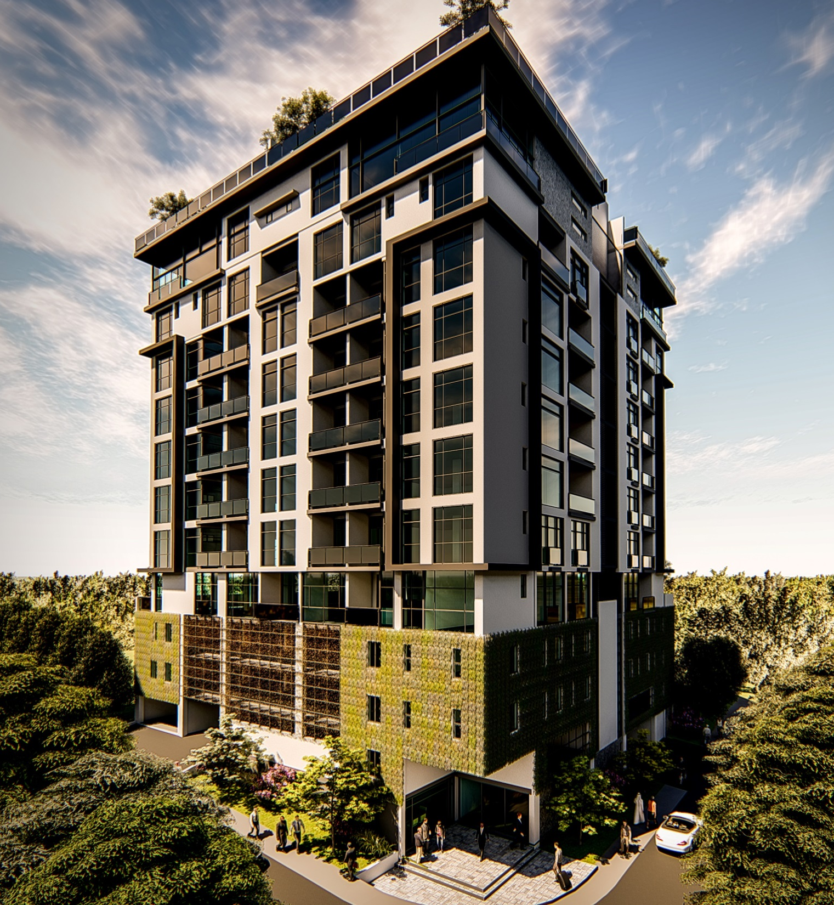

ON ELIZABETH
PARKMORE
SANDTON CBD

Slide 2
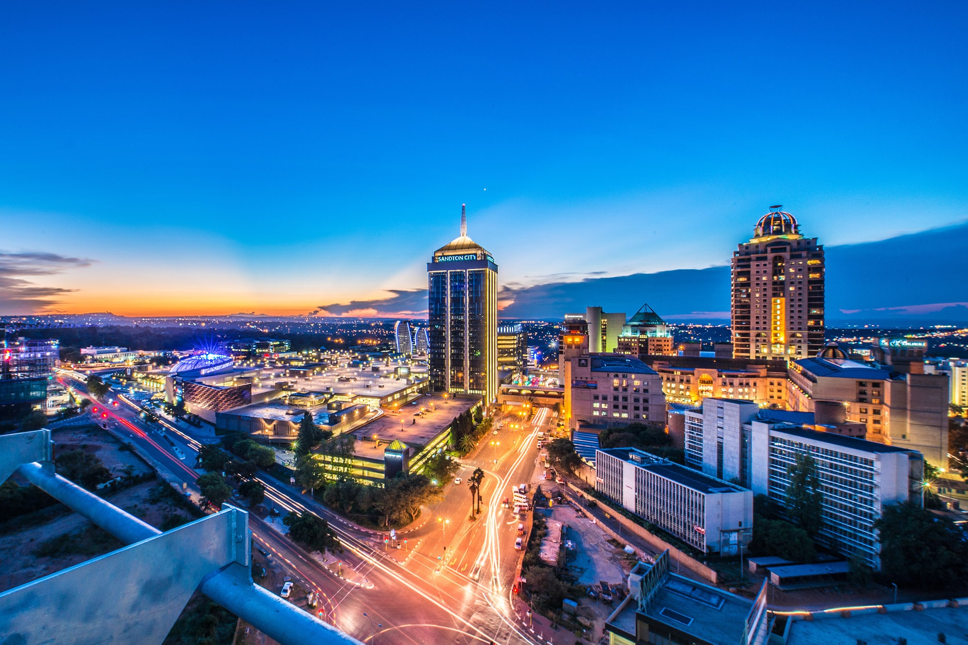
OWN YOUR VIEW OF

Slide 3
THE CITY SKYLINE

Slide 4
WELCOME TO 96 on ELIZABETH:
Inspired by modern designs that feature clean, contemporary lines and stylish finishes, 96 on Elizabeth is the latest addition to the prestigious neighbourhood of Sandton – offering European style, designer apartments at a price that’s unheard of in this sought-after area.
Comprising of a mix of studio, 1, 2 and 3 bedroom apartments including penthouses, this exclusive development is ideal for those who enjoy the benefits of central living but still want to relax in a space that indulges their senses and takes them away from it all.
MODERN, INNERCITY LIVING

Slide 5
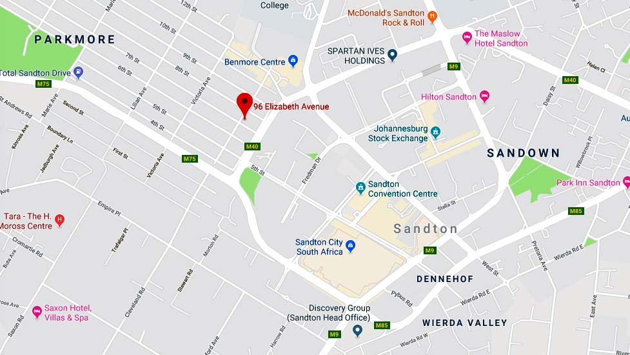
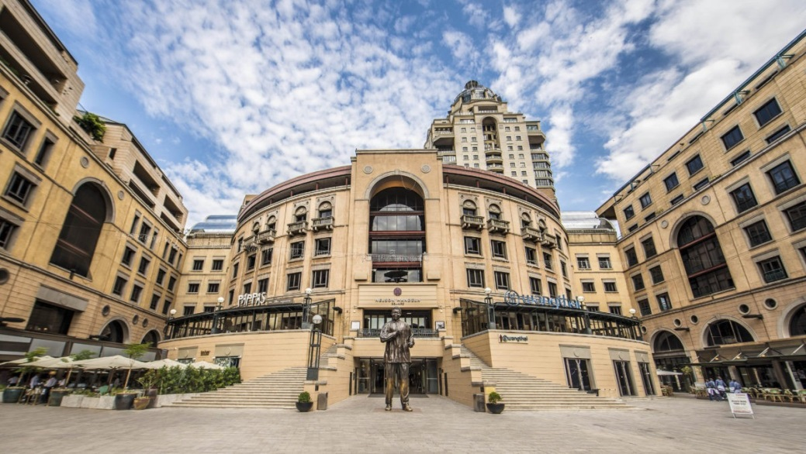
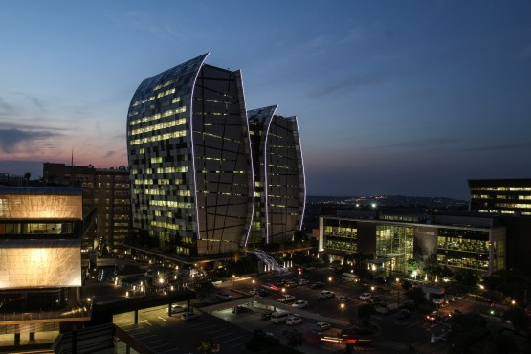
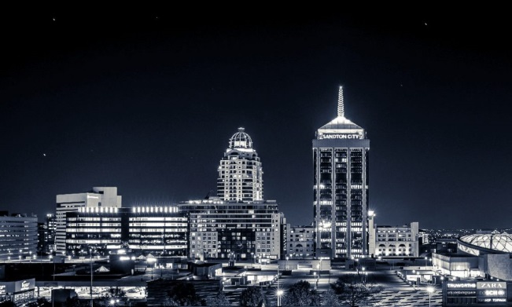
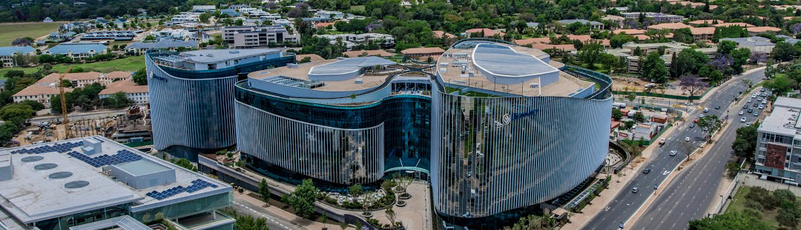
Find yourself in the Heart of Sandton

Slide 6

Are you working in the Sandton CBD and spending endless hours in traffic?
Why not enjoy a walk to the office?

Slide 7

Are you a young professional and want to start your own life?
We are the right choice for you.

Slide 8


Or a young couple that needs a convenient school location?
We have many option to choose from…

Slide 9

What about enjoying your retirement with convenience?
We have it all

Slide 10
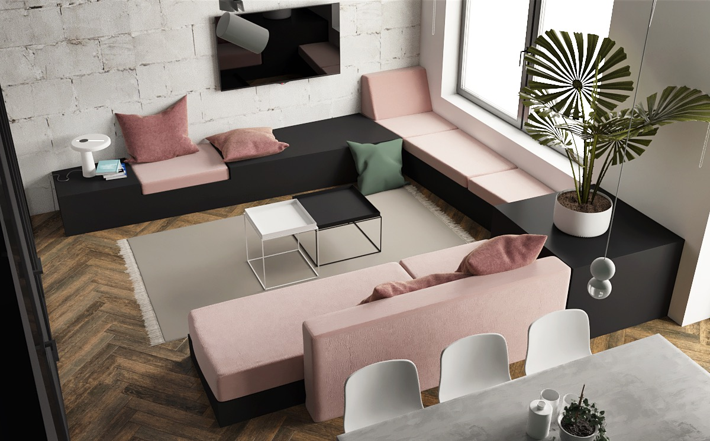
Unit Types

Slide 11
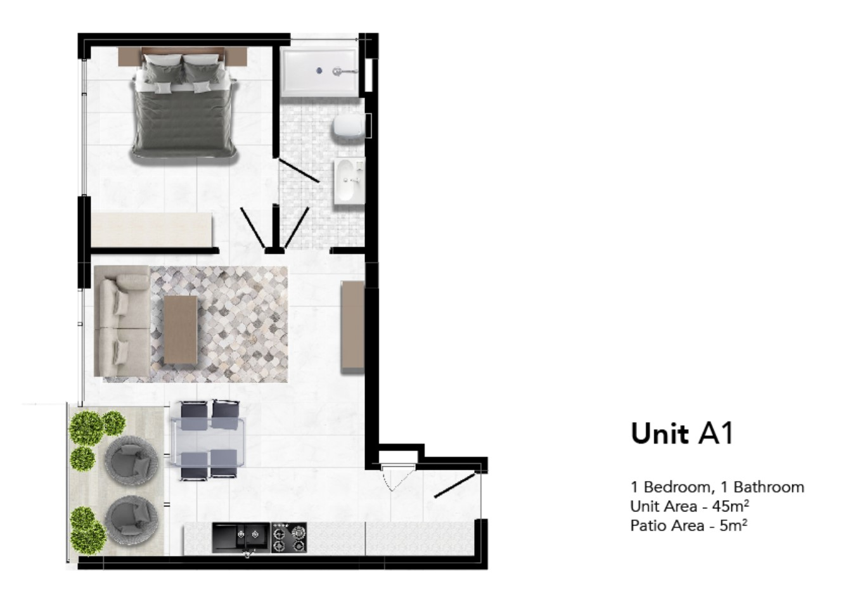

Slide 12
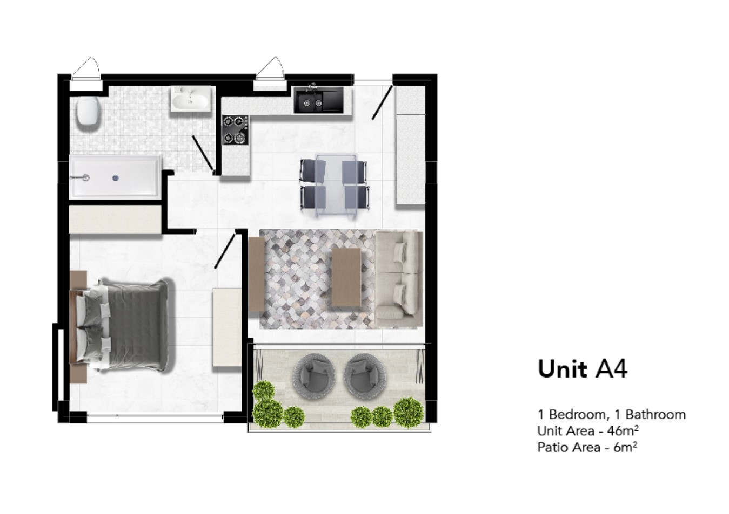

Slide 13
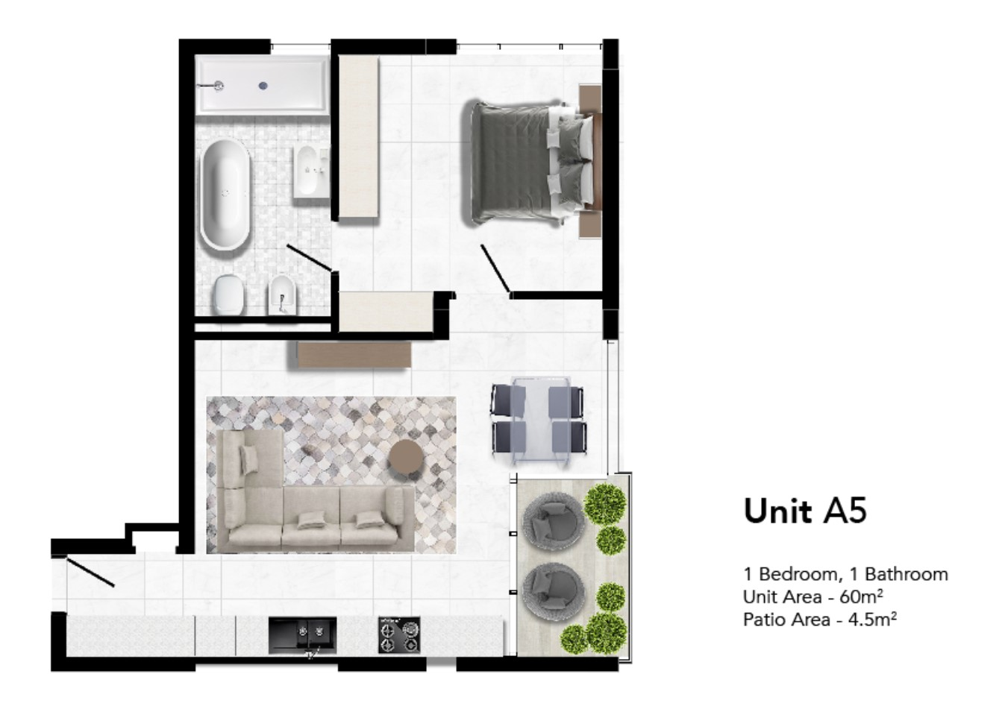

Slide 14
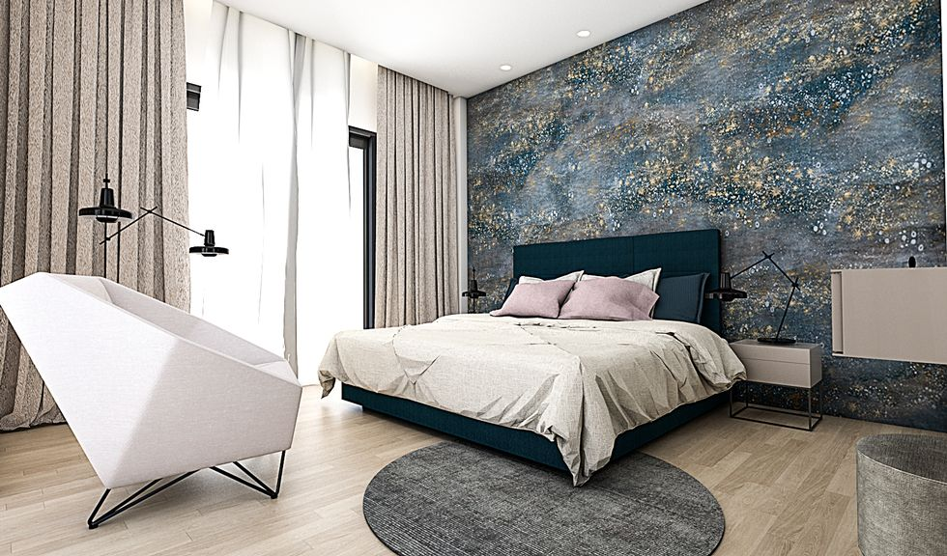

Slide 15
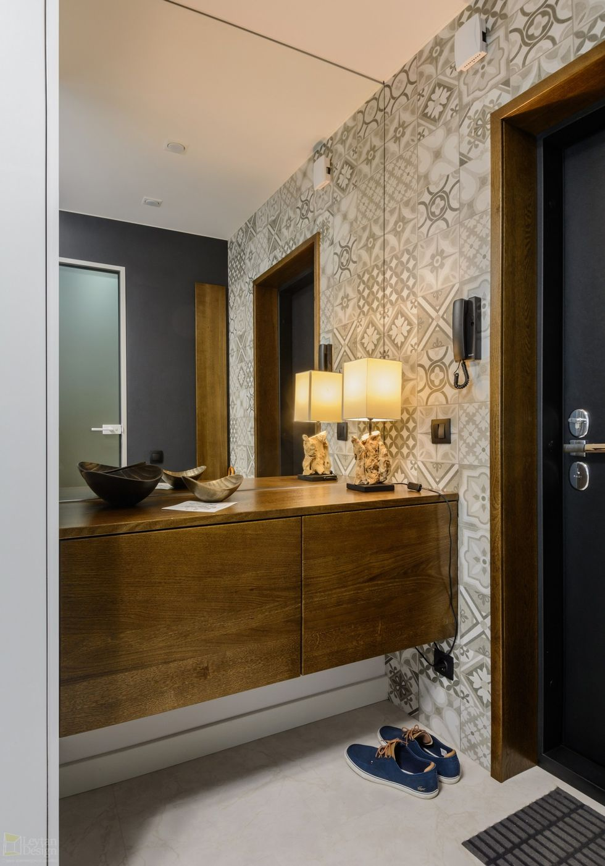
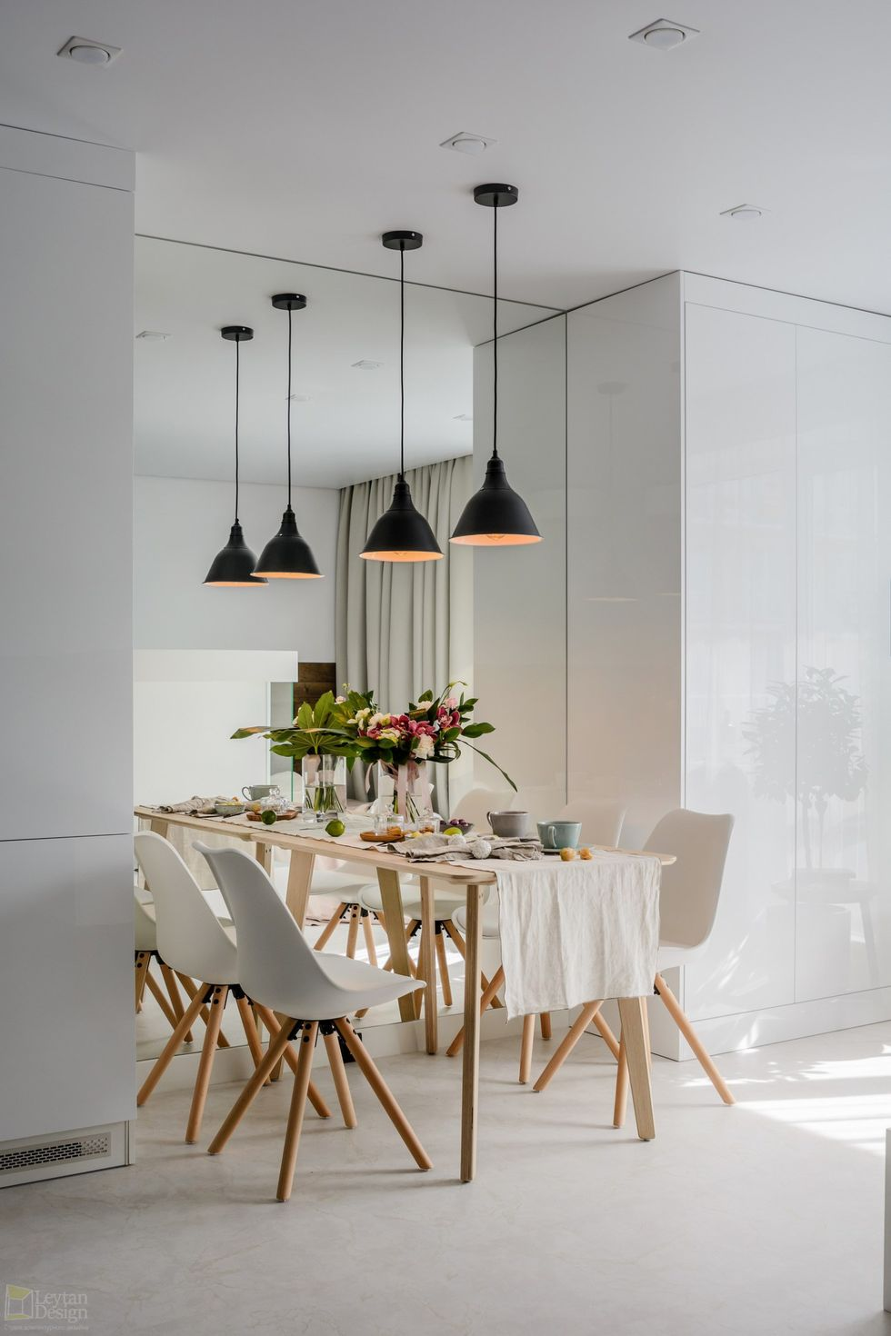

Slide 16
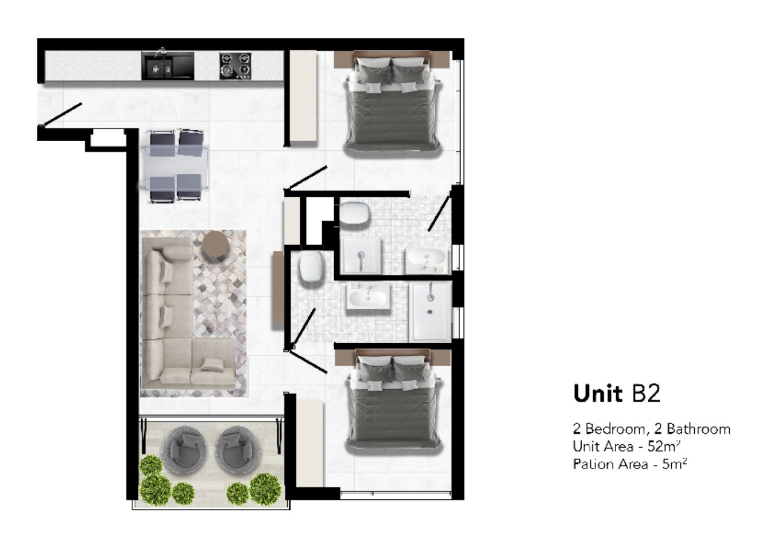

Slide 17
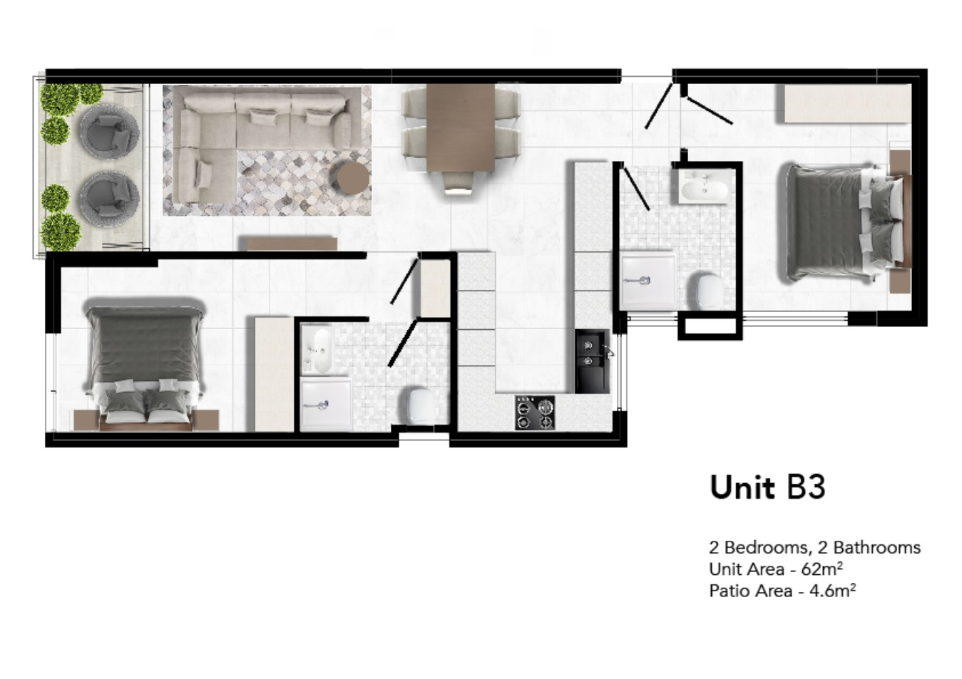

Slide 18
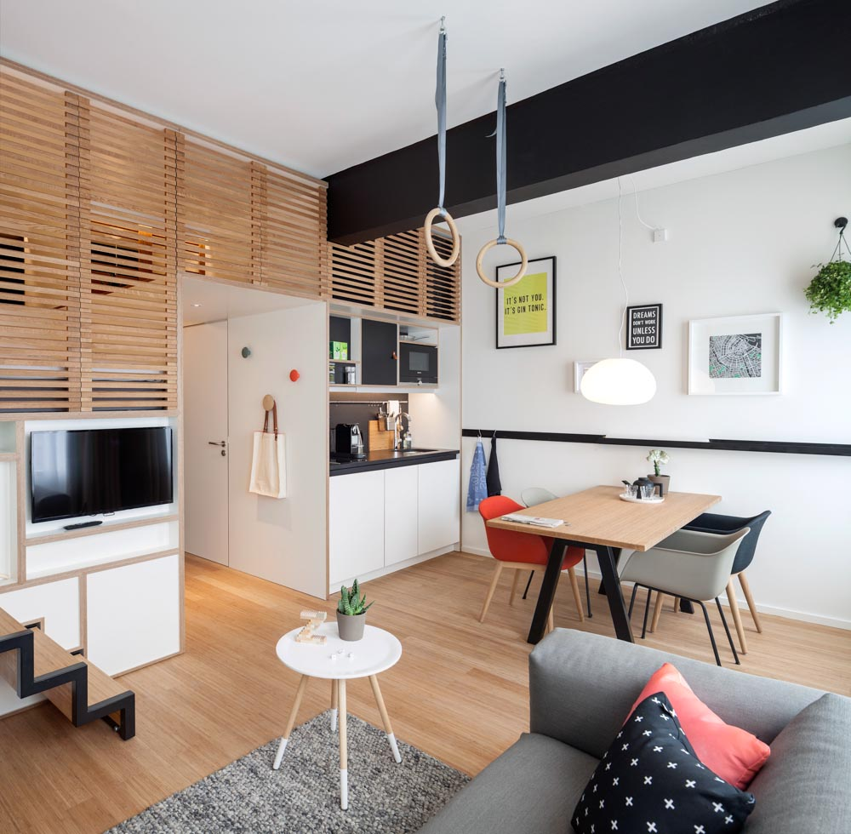

Slide 19
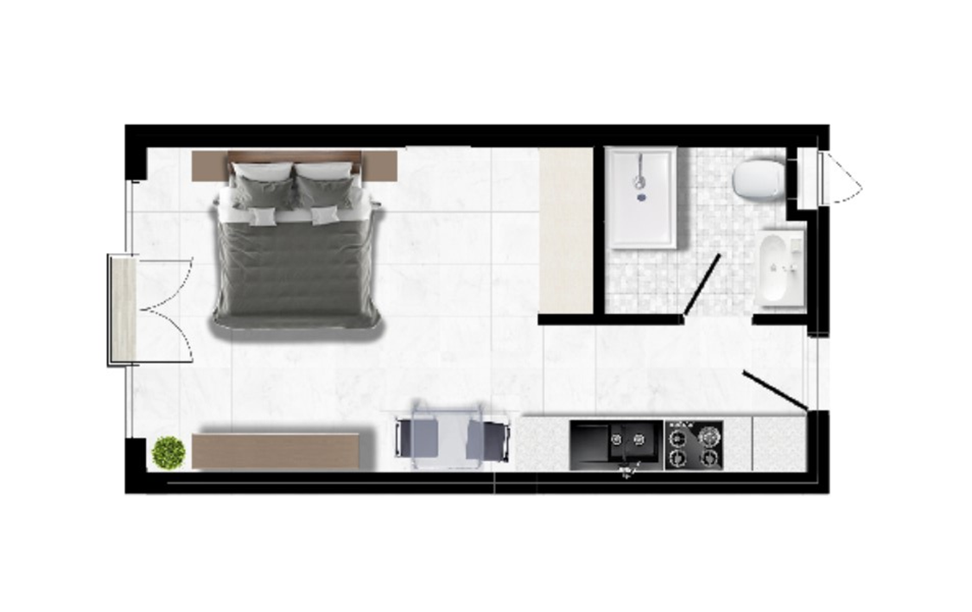

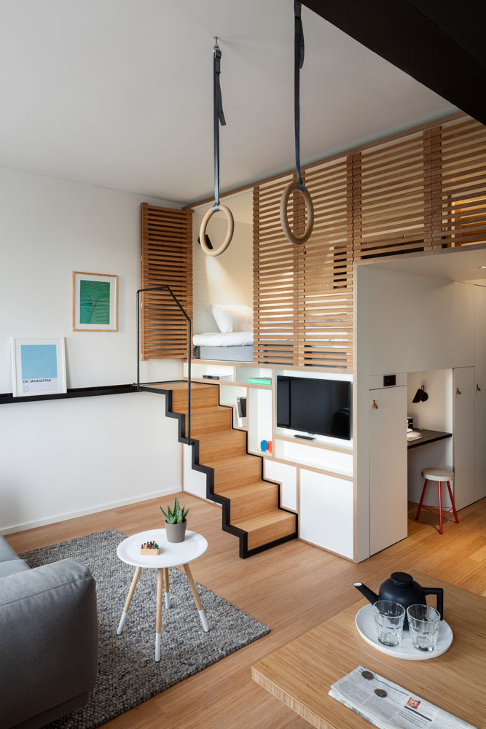


Slide 20
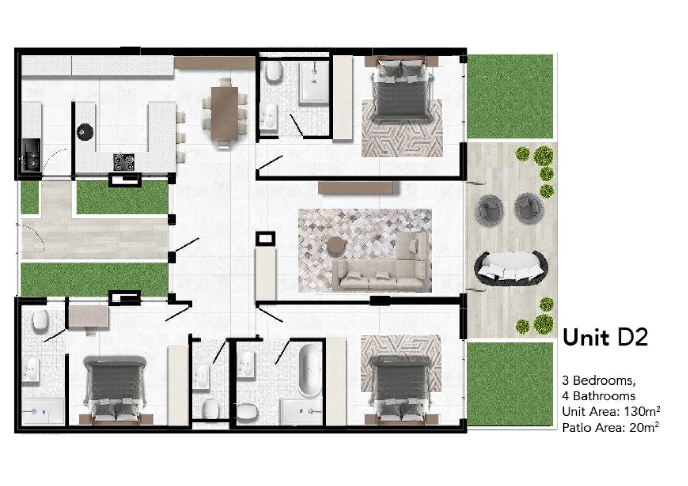

Slide 21
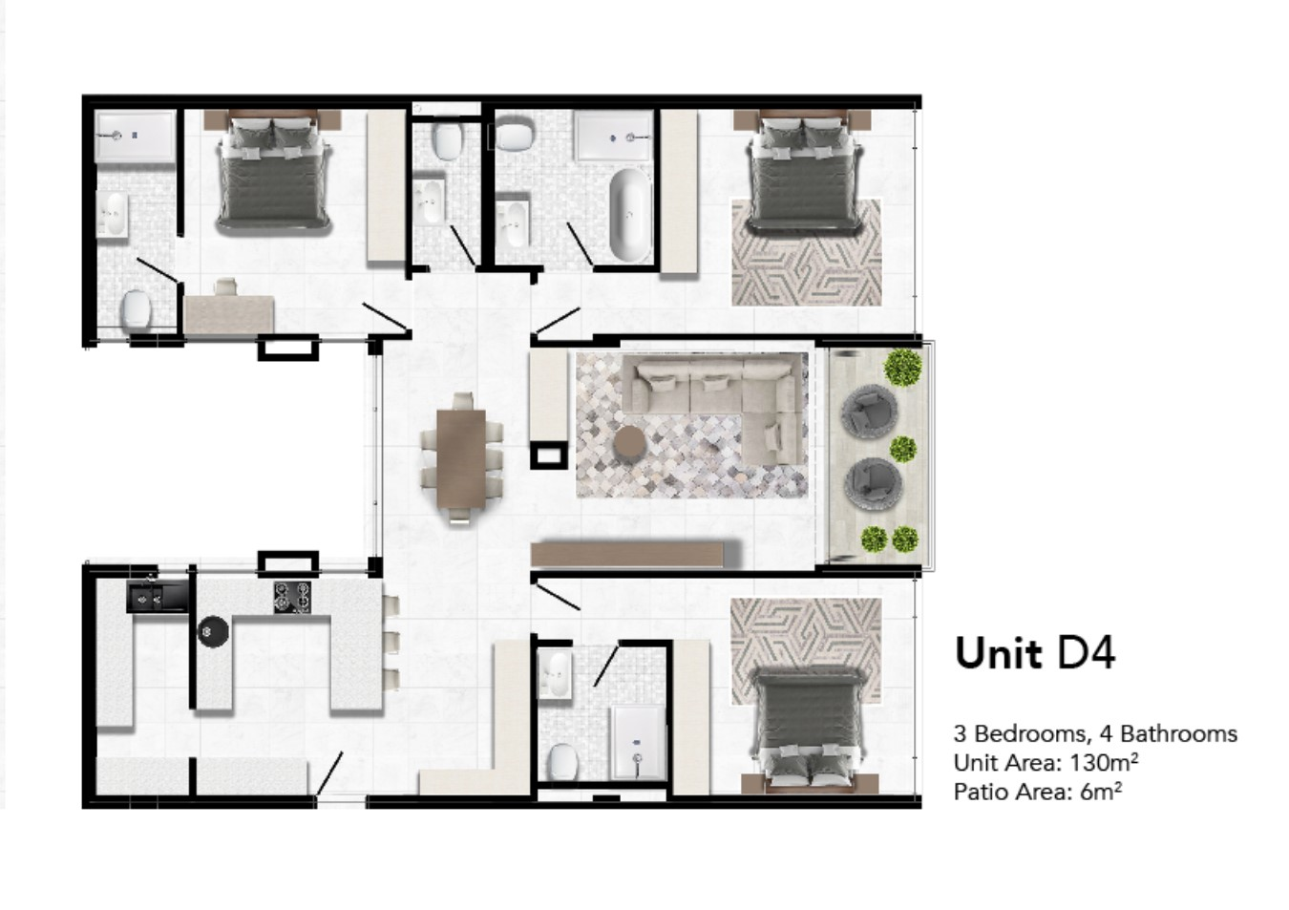

Slide 22
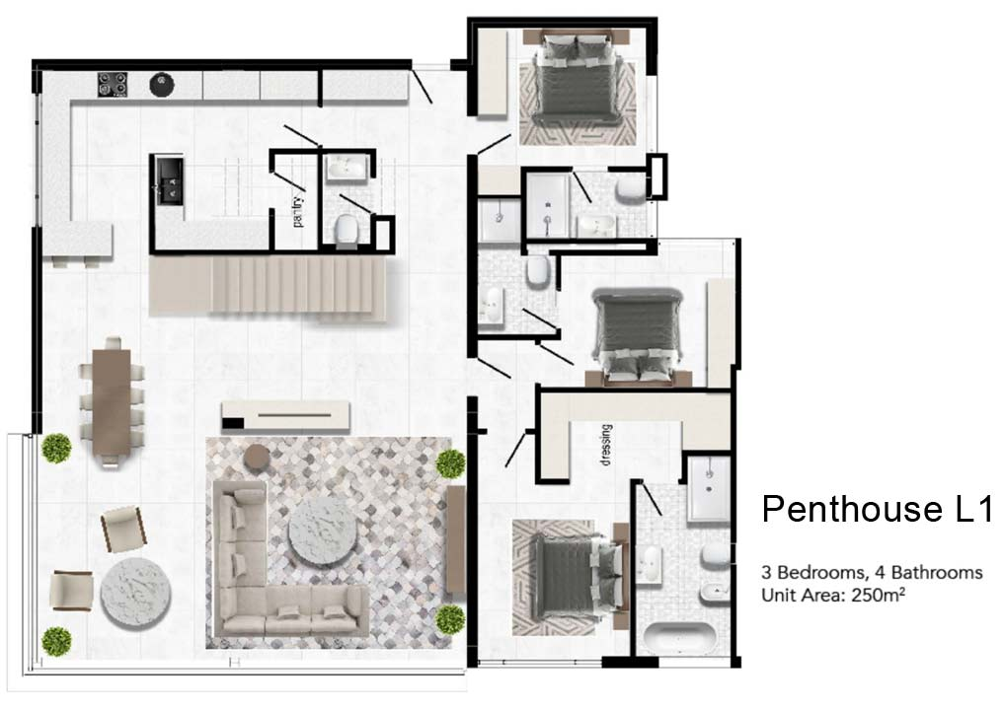

Slide 23
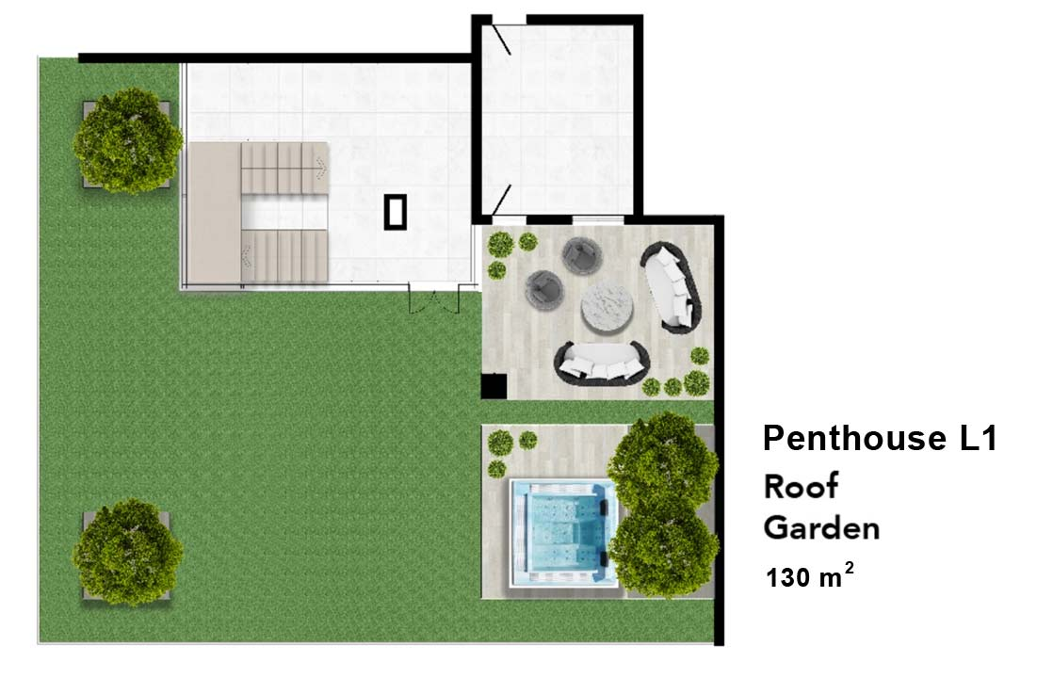

Slide 24

Interested in Joining the Revolution?
Sign-up to be a Co-Developer today!
Unit structure and co-developer cost:
STUDIO: Size: from 25sqm Price: from R745,000
1 BED + 1 BATH + 1 BASEMENT PARKING BAY Size: from 47sqm Price: from R1,380,000
2 BEDS + 2 BATHS + 1 BASEMENT PARKING Size: from 56sqm Price: from R1,630,000
3 BEDS + 3 BATHS + 2 BASEMENT PARKING Size: from 107sqm Price: from R3,100,000

Slide 25
Join the Revolution
ON ELIZABETH
ABOUT THE DEVELOPMENT
96 ELIZABETH is a sectional title residential development situated in Parkmore, Sandton, at the corner of Elizabeth Avenue and 7th Street, measuring 991sqm (31,5m x 31,5m) in extent. The total approved bulk for construction will be 5946 sqm. As a part of Sandton CBD precinct, this up-market residential development will provide the owners and tenants with a rare opportunity to be within a few hundred meters walking distance of major shopping malls, schools, offices, Morningside Hospital, hotels and the Gautrain station.
A unique opportunity for Investors/Co-developers, willing to invest in a sectional title development and purchase residential units/apartments at a cost price starting from R28,995/m2 inclusive of VAT/transfer cost for living, rental (short term and/or long term) or a combination of these two. Our Co-development also provides a solid ROI opportunity and/or quick resale.
96 ELIZABETH consists of 95 Scandinavian type and size apartments, which can be consolidated in bigger units, to meet our Co-developers needs and requirements. A variety of units are available, consisting of studios, one bedroom, two bedroom and three bedroom apartments and top floor penthouses with roof gardens. In addition, there are limited staff accommodation units and store rooms available in the upper parking levels which will be sold on a ‘first come, first served ‘basis. Top finishes will be installed in this upmarket development including modern kitchen, gas appliances, porcelain floor and wall tiles, wooden flooring, climate control and centrally heated water.
Egoli Gas will be available in all units in this development. Due to the ongoing problems with consistent electricity supply, Egoli Gas will also be utilised for the production of electricity (gas generator), hot water and cooking purposes. All utilities will be provided on a ‘pay-per-use’ smart metering system. A smart security system will provide Word class of safety for our Co-developers.
CO-DEVELOPMENT MODEL
This development model has been created for those individuals, companies, institutions, organizations, government agencies and expatriates who wish to become Co-developers and purchase their unit(s) at a cost price which does not include a developers profit (usually 25%-35%), just a 3.75% Development Coordination Fee.
Co-developers should be sufficiently liquid to finance their investment in 96 ELIZABETH as per the schedule of Progress Payments which forms part of the Purchase/Investment Agreement. This project is not financed by any financial institution and as a consequence there is no interest cost applicable. The Development is adjacent to the prime Sandton CBD, and the projected value per sqm of your unit on completion should be more than 40% higher than the cost price.
The Development concept and rezoning application is for: Residential 3: (apartments) fully equipped and furnished (optional); Height: 7-8 storeys; Floor Area Ratio 6; Coverage 80% for the top-structure and 100% for basement parking.
There will be a Management Company appointed to run the completed development. Concierge services will be available, including on demand cleaning, servicing and laundry, etc. This service is optional. Sigma Estate Management Services has been appointed to assist the Management Company with building administration and facilities management. The operating Levy will be market related and will only include those additional services chosen by each Co-developer. Co-developers can place their apartments into a rental pool and earn a yield of 10% per year. This rental pool agreement will be for 12 months, renewable annually for selected units.

Slide 26
First Come,
First Serve..
CO-DEVELOPMENT PROCESS
THE FOUNDERS identified and purchased the property at 96 Elizabeth Avenue, Parkmore, Sandton (ERF 775 Parkmore) as being suitable for sectional title development. The FOUNDERS applied for rezoning and managed the rezoning process, prepared and implemented the marketing of the development, instituted and managed all professional work with regard to the development.
Operating as Principal Agent during the construction of the development, the FOUNDERS managed all legal work, including company registration, shareholders agreement, opening of a registered trust account, drafting sub-contractors agreements and conveyancing work regarding preparation for Sectional Title registration.
Co-developers should identify the unit(s) they are interested in, sign the Agreement and be issued company shares proportional to the size of their unit(s). For example: if there is 5,000 m2 of total unit area for sale and the size of the unit that our Co-developer chooses is 50m2, they will be issued 50 shares. Please note that these are not profit shares as the company is constructing the development at a cost price of R28, 995/m2 inclusive of VAT, if applicable.
The Founders guarantee to the Co-developers that a cost price of R28,995/m2 inclusive of VAT will not be increased during construction period.
Co-Developer Payment Schedule:
Progress Payments by Co-developers will apply as follows:
On signature of the Agreement, Co-developer will pay a deposit of 1% of the total purchase price to the Attorney (Richard Meaden and Associates) Trust Account. The deposit (plus interest) is refundable if, in 90 days, the Founders don’t reach sales of 25% of the total saleable area or don’t obtain rezoning approval as originally applied for. Thereafter, a Commencement date will be published and construction will commence.
Once the Founders meet the conditions per 1(a) above, the Co-Developer should, as per the Agreement, pay a further deposit of 14% into the Company account which, together with the original 1% previously deposited into the Attorney Trust Account, be used as per schedule (3) Cash-flow projection.
All payment will be according to the Cash flow projections, scheduled, accepted and signed by the Co-developer’s on signature of the Agreement. If at any stage during construction the Co-developer decides to cancel their Agreement, their investment in development to date will be refundable at the completion of the development and will be refunded, together with the applicable interest earned on their deposit in the Attorney Trust account.

Slide 27
ON ELIZABETH
Contact us Today:

Slide 28
ON ELIZABETH

